Slide 1






Your Voice Matters. Don’t Let AI Drown It Out
Checkpoint
Ângela Ribeiro (109061)
João Santos (110555)
João Viegas (113144)
Hugo Castro (113889)
Ana Rita Silva (114220)
Advisors:
Prof. João Rafael Almeida
Vicente Barros

Slide 2

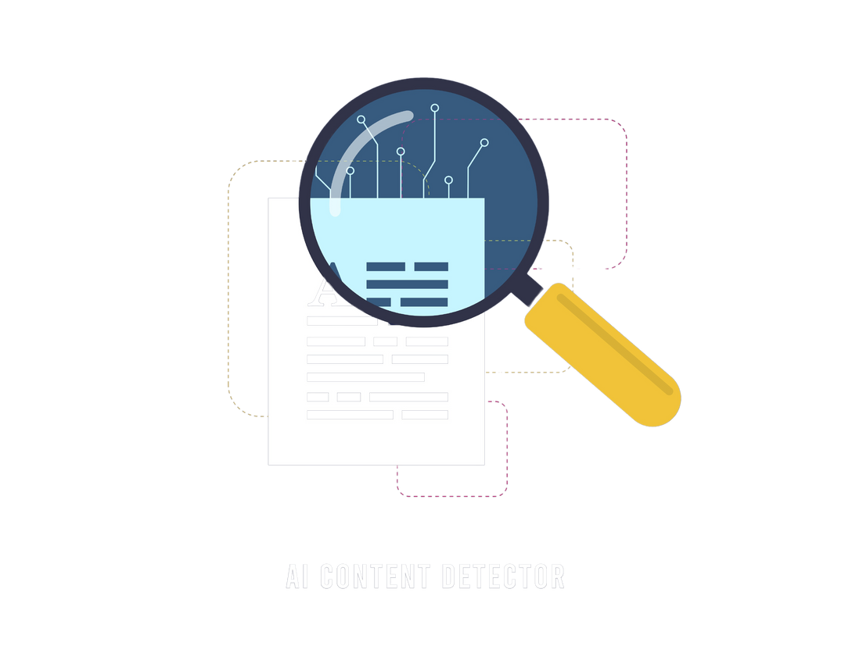
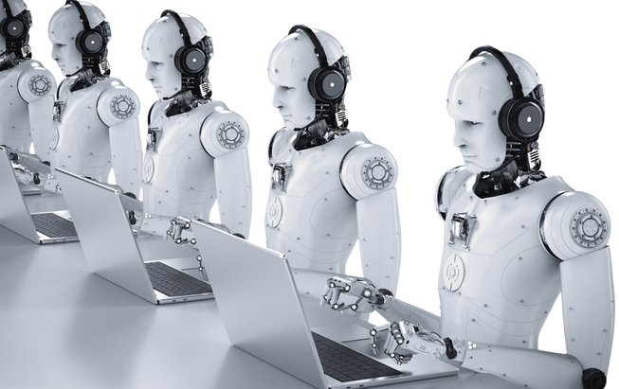

INTRODUCTION
Detection and Blocking
AI Bots
Website + Extension
Manipulating engagement and spreading misinformation.
Detect and block interactions with AI profiles.
Identifying AI-driven accounts for transparency.
2
Notes:
presença de bots nas redes sociais
website+extensão
detectar e bloquear

Slide 3

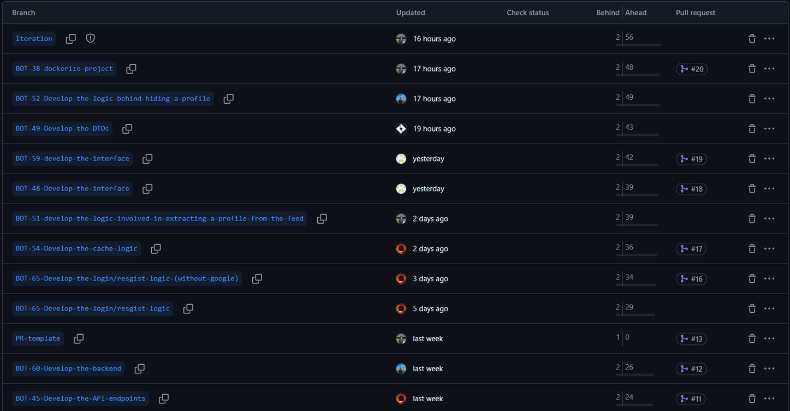
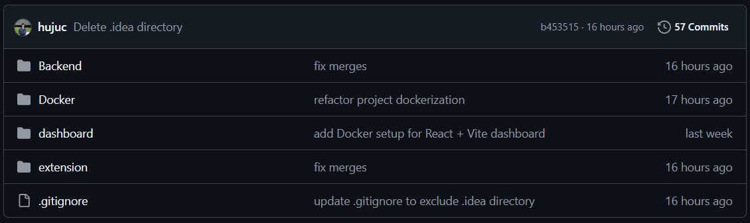
GITHUB
2

Slide 4
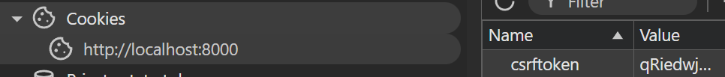

CURRENT DIFFICULTIES
Login with Google
Experiencing difficulties regarding logging in with the Google services.
4
Notes:
ângela

Slide 5
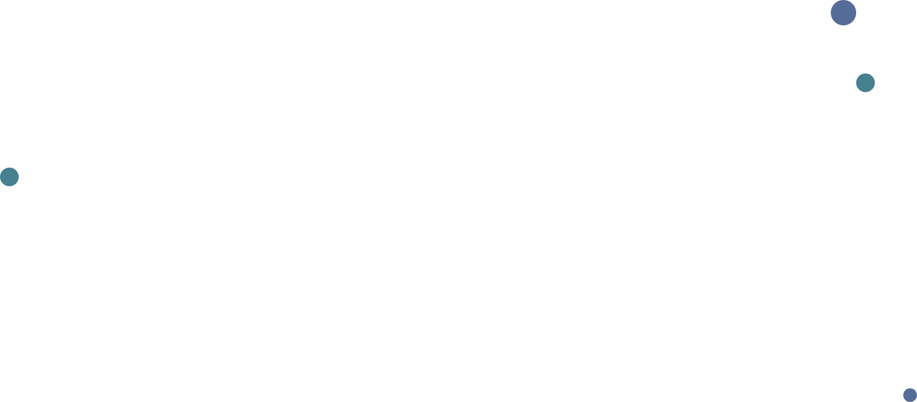
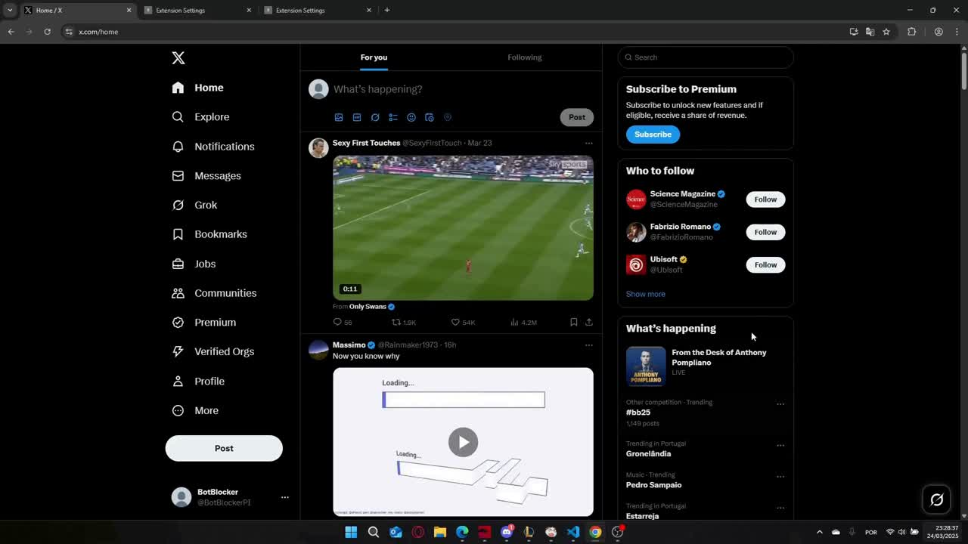
VIDEO DEMO
3
Notes:
ugo
Mockups
extensão e website

Slide 6
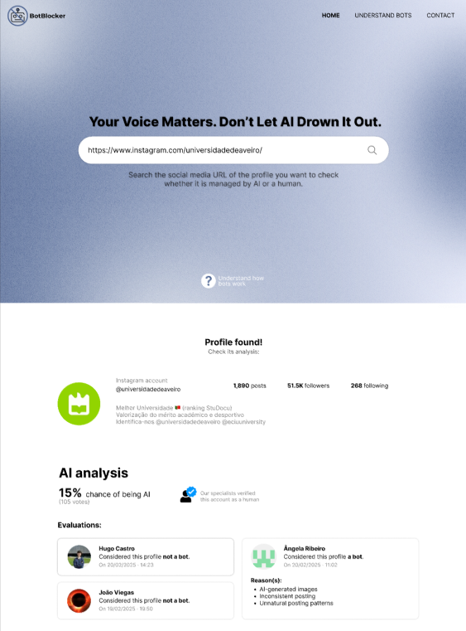
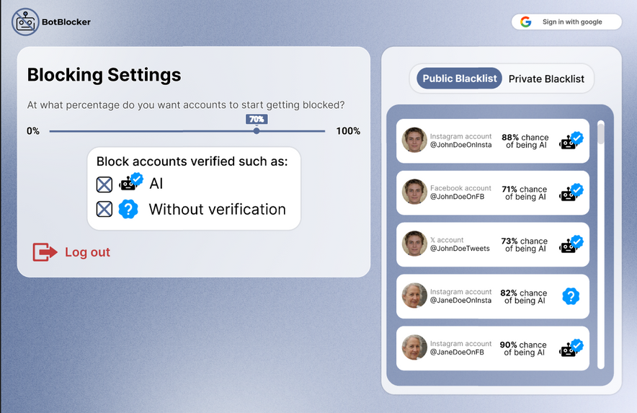
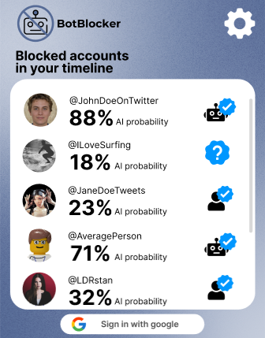
NEAR FUTURE IMPLEMENTATIONS
4
Notes:
ângela

Slide 7
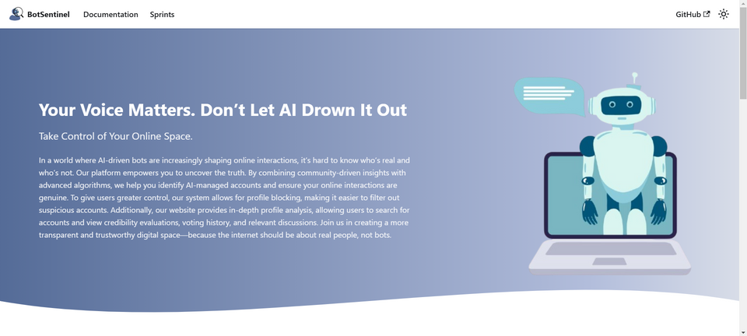


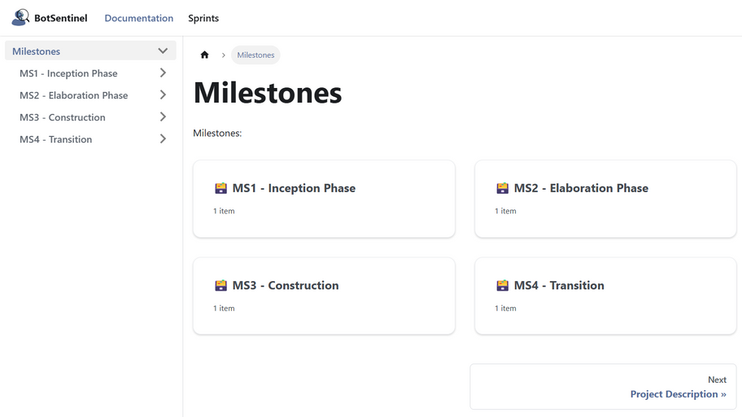
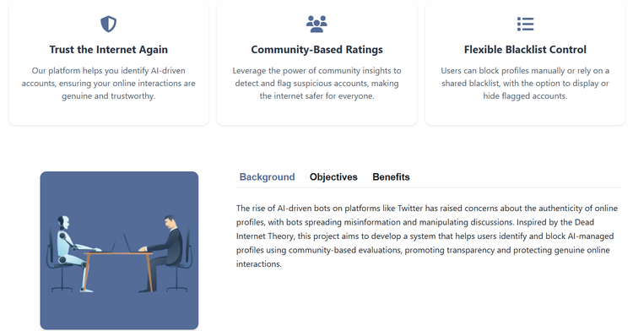
Thank you!
https://botblocker-pi.github.io/Documentation/
5
Notes:
ângela

